Slide 1
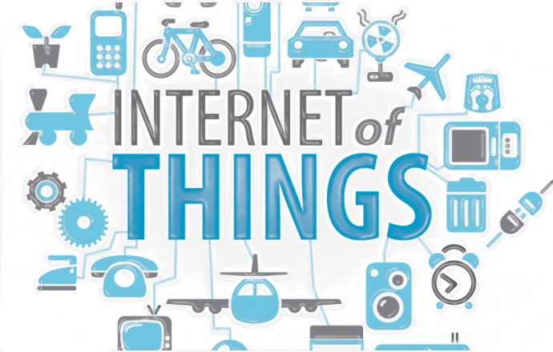
THE INTERNET OF THINGS M.DRUMARE

Slide 2
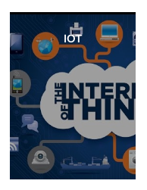
ON FLIPBOARD
http://flip.it/YwfNNG

Slide 3
WHAT?

Slide 4

WHAT IS IoT?
IOE, IoT, IIoT, M2M, INDUSTRY 4.0.
IoT IS HYPE.
IoT IS THE NEXT BIG BUSINESS.
IoT IS EVERYWHERE.
IoT IS FOR EVERYTHING.
WHAT IS A SMART AND CONNECTED PRODUCT ?
WHAT IS THE VALUE ADDED OF A SMART AND CONNECTED PRODUCT ?
WHAT MADE IoT POSSIBLE ?

Slide 5
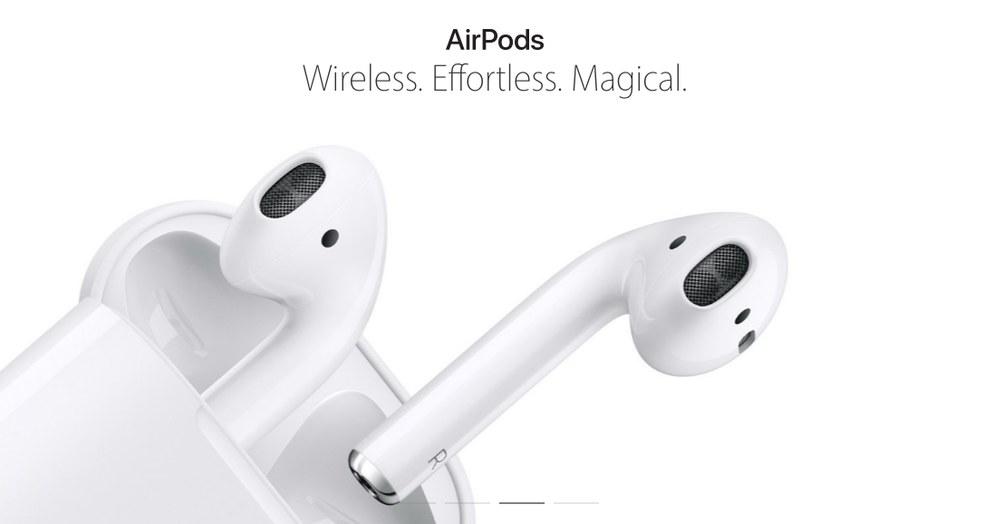


THE WIRELESS FUTURE
What AirPods can tell us about Apple's future?
http://www.macworld.com/article/3118892/iphone-ipad/what-airpods-can-tell-us-about-apples-future.html

Slide 6
IOE, IOT, IIoT, M2M, INDUSTRY 4.0
IoE (Internet of everything)
IoT (Internet of things)
I IIoT (Industrial Internet of things)
M2M (Machine to Machine)
Industry 4.0
IoT Basics : https://iot-analytics.com/wp/wp-content/uploads/2015/03/2015-March-Whitepaper-IoT-basics-Getting-started-with-the-Internet-of-Things.pdf

Slide 7
INTERNET OF EVERYTHING
People: Connecting people in more relevant, valuable ways.
Data: Converting data into intelligence to make better decisions.
Process: Delivering the right information to the right person (or machine) at the right time.
Things: Physical devices and objects connected to the Internet and each other for intelligent decision making; often called Internet of Things (IoT).
Internet of everything Commercial by Cisco, January 2014.
Cisco website on the Internet of everything
http://ioeassessment.cisco.com/fr/

Slide 8
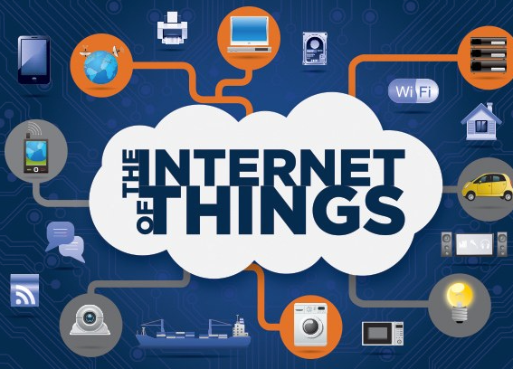
THE INTERNET OF THINGS
Kevin Ashton is accredited for using the term “Internet of Things” for the first time during a presentation in 1999 on supply-chain management
He believes the « things » aspect of the way we interact and live within the physical world that surrounds us needs serious reconsideration, due to advances in computing, Internet, and data-generation rate by smart devices.
How It Works: Internet of Things by IBM, September 2015.

Slide 9
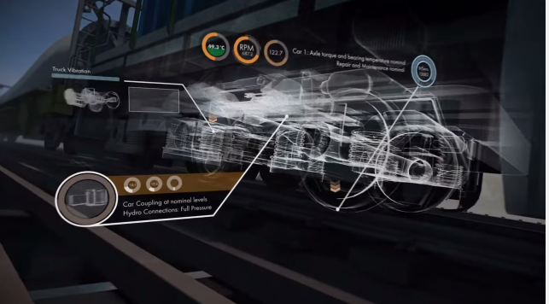
Industrial Internet (of Things)
The term industrial internet is strongly pushed by GE.
It goes beyond M2M since it not only focuses on connections between machines but also includes human interfaces.
GE Digital: The Industrial Internet in the Real World, April 2013.

Slide 10
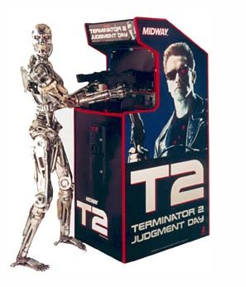
M2M (MACHINE TO MACHINE)
M2M communication had initially been a one-to-one connection linking one machine to another.
But today’s explosion of mobile connectivity means that data can now be more easily transmitted, via a system of IP networks, to a much wider range of devices.
Cellular machine-to-machine (M2M) connections will reach 733 million globally by 2021,
Total cellular M2M service revenues will reach a global annual total of $67 billion in 2021.

Slide 11
INDUSTRY 4.0
Industry 4.0 describes a set of concepts to drive the next industrial revolution.
It includes all kinds of connectivity concepts but also goes further to include real changes to the physical world around us such as 3D-printing technologies, new augmented reality hardware, robotics, and advanced materials.
Siemens, 2013
Volkswagen, 2014
Mercedes Benz, 2015
The term Industry 4.0 is strongly pushed by the German government and industries.
Germany Trade & Invest, 2016

Slide 12
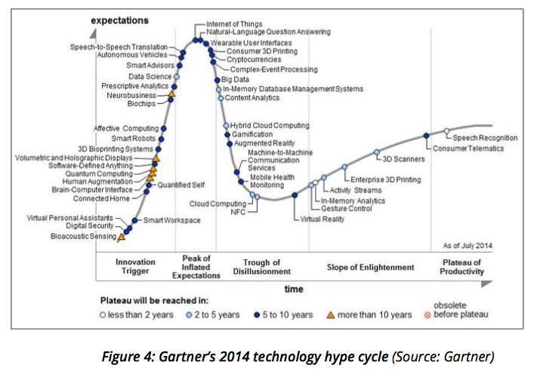
IOT IS HYPE

Slide 13
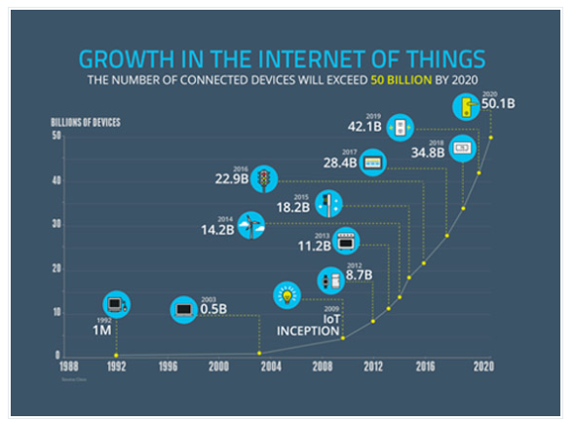
IoT,THE NEXT BIG BUSINESS
Worldwide market for IoT solutions to reach $7.2 trillion in 2020 (IDC)
Economic value-add is forcat to be $1.9 trillon across sectors in 2020 (Gartner)
Leading Industries examples :
Utilities, insurance, agriculture, factory, automobile, transport, consumer, etc….

Slide 14
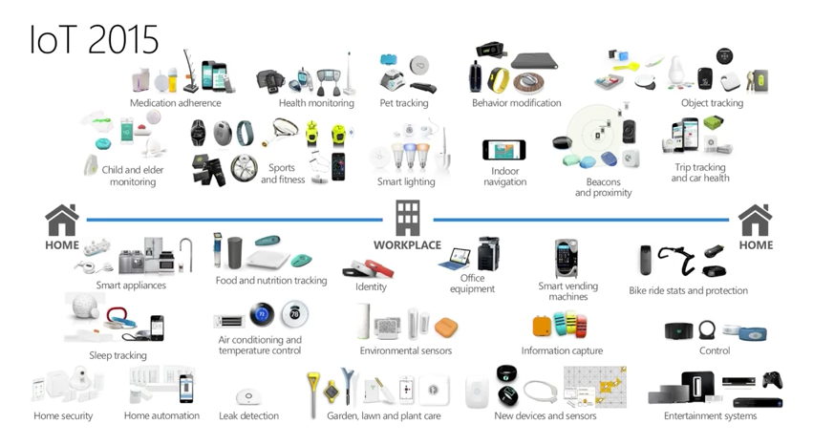
IOT IS EVERYWHERE
IoT, a new connected world, Feb 2016

Slide 15
IOT IS FOR EVERYTHING
Domotic and Smart Home
Wearables and Smart Monitoring
Smart City
Smart Grids
Smart Environment
Smart Water
Industrial Internet
Logistics
Security and Emergencies
Connected Car
Connected Health (eHealth)
Smart Retail
Smart Agriculture
Smart Animal Farming
Readings: top 50 « iot sensor applications ranking »
http://www.libelium.com/resources/top_50_iot_sensor_applications_ranking/

Slide 16
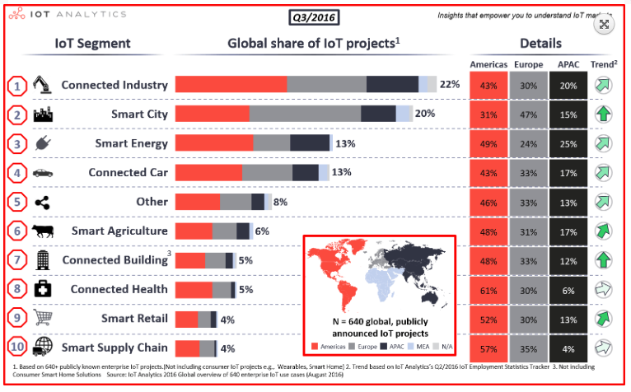
IOT IS FOR EVERYTHING

Slide 17
What is a smart anD connected product ?
Physical components : the product’s mechanical and electrical parts.
Smart components : the sensors, microprocessors, data storage, controls, software, an embedded operating system and enhanced user interface.
Connectivity components : the ports, antennae, and protocols enabling wired or wireless connections with the product.

Slide 18
Connectivity serves a dual purpose
Information is exchanged between the product and its operating environment : its maker, its users, and other products and systems.
Functions of the product exist outside the physical device: in the product cloud.
Stream music at home: SoundTouch Wi-Fi music systems from Bose, Oct 2013
ABB Smart Grids - enabling a stronger, smarter and greener grid, Avril 2016
Schindler's Port Technology - Easy as 1-2-3, Jul 2013
Philips Hue, Oct 2015

Slide 19
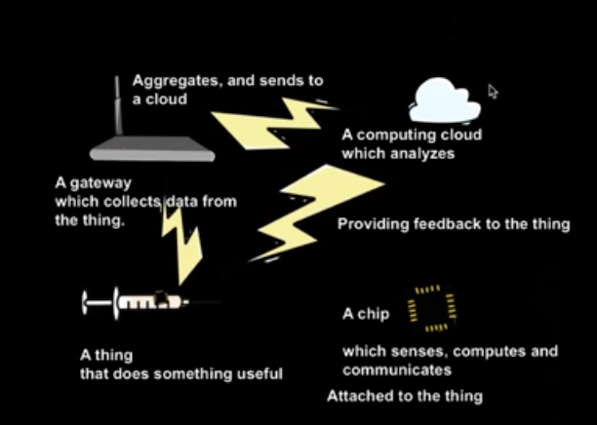
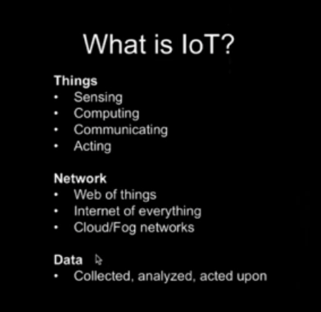
What is a smart anD connected product ?

Slide 20
Monitoring Value added
Alert users or others to changes in circumstances or performance.
Track a product’s operating characteristics and history and to better understand how the product is actually used.
Market segmentation through the analysis of usage patterns by customer type.
After-sale service by allowing the dispatch of the right technician with the right part. Warranty compliance issues.
New sales opportunities, such as the need for additional product capacity because of high utilization.

Slide 21
CONTROL, OPTIMIZATION, AUTONOMY VALUE ADDED
Control Value added
Customization of product performance to a degree that previously was not cost effective or often even possible.
Enables users to control and personalize their interaction with the product in many new ways.
Optimization added
Preventative maintenance when failure is imminent.
Accomplishing repairs remotely.
Reducing product downtime and the need to dispatch repair personne.
Autonomy Value added
Reduce the need for operators but can improve safety in dangerous environments and facilitate operation in remote locations.
Autonomous products can also act in coordination with other products and system.

Slide 22
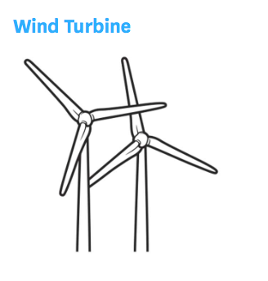
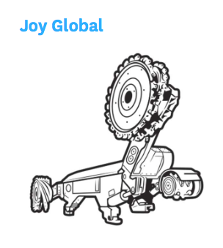
WIND TURBINE & MINING MACHINE

Slide 23
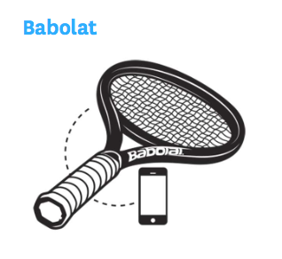
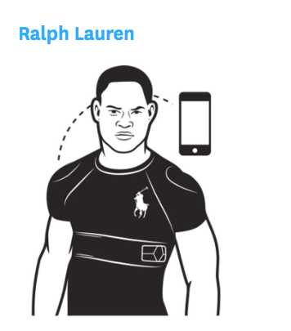
SMART TENNIS RACKET & WEARABLE

Slide 24

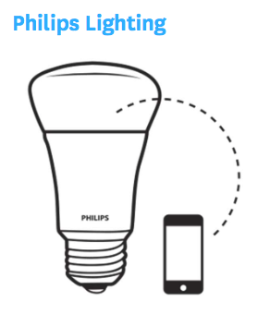
MEDTRONIC BLOOD GLUCOSE METER
PHILIPS LIGHTING
AND CARREFOUR

Slide 25
What made IOT possible?
Breakthroughs in the performance, miniaturization, and energy efficiency of sensors and batteries.
Highly compact, low-cost computer processing power and data storage (computers inside products)
Cheap connectivity ports and ubiquitous, low-cost wireless connectivity.
Tools that enable rapid software development ans Big Data analytics.
A new IPv6 internet registration system opening up 340 trillion trillion trillion potential new internet addresses for individual devices.
New protocols that support greater security, simplify handoffs as devices move across networks and allow devices to request addresses autonomously without the need for IT support.

Slide 26
What made IOT possible?
New IP adress 6LoWPAN
(IPV6 over Low Power Wireless Personnal Area Networks)
New Protocols : REST, MQTT, CoAP
Rapid Software development : How to make a Connected Sensors?

Slide 27
HOW TO ?

Slide 28



HOW TO IMPLEMENT THE IoT?
a new Technology Stack
EXPERTISE IN PRODUCT DESIGN
IMPLEMENT NEW AFTER-SALE SERVICES
IMPLEMENT NEW MARKETING PRACTICES
NEW HUMAN RESSOURCES CHALLENGES
MAKE NEW STRATEGIC CHOICES : COST, DATA, SERVICES
FOCUS ON IoT COMPANIES:TESLA, GE, WHIRLPOOL

Slide 29
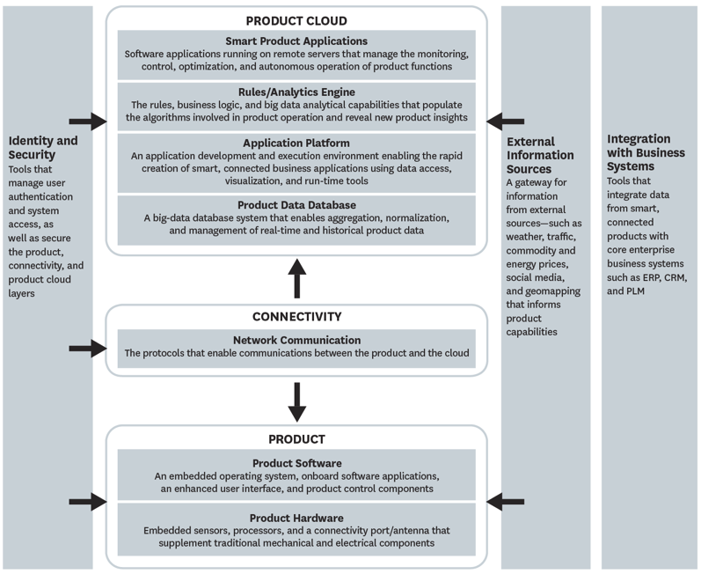



a new Technology Stack

Slide 30
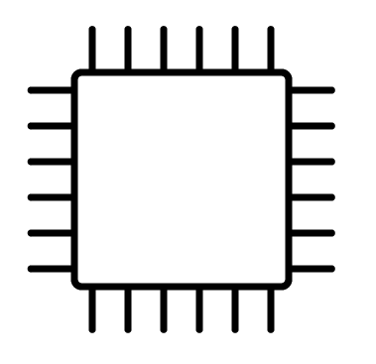
EXPERTISE IN PRODUCT DESIGN
Organizations need expertise in systems engineering and in agile software development.
New design principles.
Hardware standardization.
Software-based customization.
Personalization.
On-going product upgrades, remote services.

Slide 31
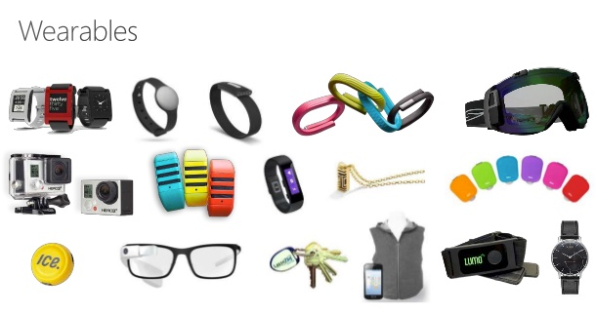
EXPERTISE IN PRODUCT DESIGN
User-centered design : define a problem that truly matters custumers.
Understand the technology stack and the user experience.
Adopt a technology approach to design.
Follow a built-test-learn process : evolution of the design according to the customer experience.
Simplify for success: Technologist and designers must approach IoT development with a ‘less is more’ mandate.
Need of a new partnership between those who understand the user ans who integrate the technology.

Slide 32

IMPLEMENT NEW AFTER-SALE SERVICES
Organizations need data expertise to implement data driven after-sales.
To Take advantage of product data.
To Make timely and remote repairs.
To evaluate real-time product usage and performance.
To identify warranty agreement.

Slide 33

IMPLEMENT NEW MARKETING PRACTICES
Organizations need to use data analytics tools and segment their market in a most significant way to deliver greater value to each segment.
To analyse product usage data.
To analyse new insights into how products create value for customers.
To better positionning products based on the data collected.

Slide 34

NEW HUMAN RESSOURCES CHALLENGES
Organizations need to recruit new skills sets.
Software development,
System engineering,
Product and software design,
Big data analytics
Secutity to secure the storage of the data, to avoid hackers.
Readings
http://www.cio.com/article/3072132/it-skills-training/10-most-in-demand-internet-of-things-skills.html

Slide 35
MAKE NEW STRATEGIC CHOICES REGARDING THE COST
Build or Buy? Develop capabilities and infrastructure internally or outsource to vendors or partners.
-In-House strategy need investments, skills and time.
-Outsourcing can create new costs and compromise the ability to differentiate going foward.
Embedded in the product vs the cloud? In addition to the cost, others factors should be taken into consideration : response time, network quality and security, interfaces, product upgrades.
To invest in IoT or not?
Which features will deliver real value to customers relative to their cost.

Slide 36
MAKE NEW STRATEGIC CHOICES REGARDING THE DATA
What Data must the company capture? Collecting Data add a cost to the product : more sensors, security, analytics software, data analysts, investment in external datas.
Who own the data collected? Who is the owner of the data streaming from a smart aircraft engine: the engine suppliers, the airframe manufacturer, the airline company?
Enter in new businesses by monetizing its product data? Data about driving characteristics are used by assurance companies.

Slide 37
MAKE NEW STRATEGY CHOICES REGARDING THE SERVICES
Fully or partially disintermediate distribution channels or service networks? Tesla sells its car directly to consumers rather than through traditional dealer network. Tesla also eliminates third party-party involvement in repairs.
Change the business model? The emergence of the product as a service model in which manufacturer retains ownership and the customer simply paid for the use of the machine.

Slide 38
MAKE NEW STRATEGY CHOICES REGARDING THE SCOPE
Open or closed system?
-Closed System: customers purchased the entire connected product system from a single manufacturer (GE and the aircraft company)
-Open System: enables the end customer to assemble the parts of the solution.
(Whirlpool designs its appliance to be ready connectable to a variety of home automation).
Expand its scope:
Car Manufacturers become Mobility companies.

Slide 39
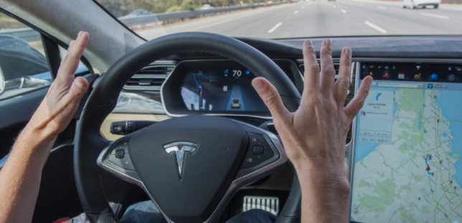
TESLA: THE SMART COMPANY
« The software update was officially named Tesla Version 7.0, but its nickname—Autopilot—was what stuck. »
« For an additional $4,250, Tesla customers could purchase a “technology package” that used the sensors, as well as a camera, a front radar, and digitally controlled brakes, to help avoid collisions—essentially allowing the car to take over and stop before crashing. »
How Tesla's Self-Driving Autopilot Actually Works
Powerwall 2 & Solar Roof Launch

Slide 40
GE : Internet Of AirLINES Things
For the airline sector, IoT offers multiple opportunities
« Even transfer buses and trains and movements within car parks will be 'sensorised'.
Within the aircraft, sensors will measure cabin temperature, air quality [and] light levels, and track catering equipment and duty-free trolleys. »
« Sensors will aspire to manage and improve stress-points across the journey.
Infrastructure such as elevators, baggage carousels, travelators, kiosks, bag-drop stations [and] boarding gates will all have sensors. »
How GE’s Predix Is Taking Aviation Productivity to New Levels

Slide 41
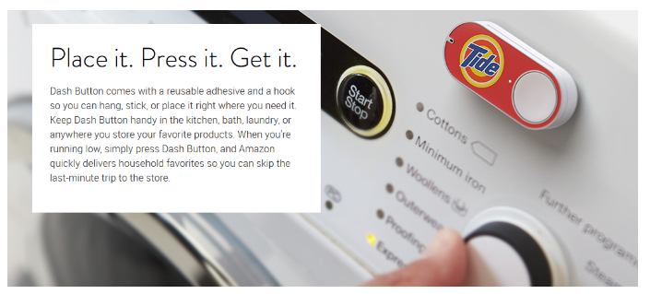

WHIRLPOOL : THE INVENTION OF THE SMART KITCHEN
« Whirlpool, which partnered with IBM Watson is using IoT for connectivity among home appliances. Since those appliances are all linked, the data can be organized and interpreted as a single data set—as opposed to separate sets of data for each appliance—and store it in the IBM cloud. The company uses that information to get a better understanding of how its products are being used, what problems are popping up and why, and how it can solve those problems quickly »
Dash Button
Whirlpool Smart Kitchen Has Touchscreens EVERYWHERE | Mashable CES 2016

Slide 42
IMPACTS ?

Slide 43
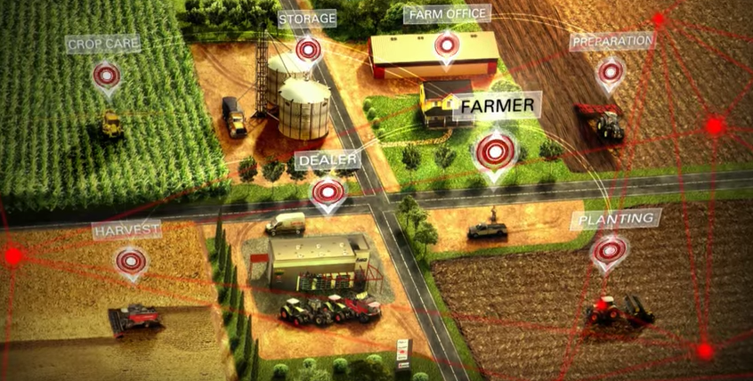
IMPACTS OF IoT
IMPACT ON THE VALUE CREATION.
Impact of connected product on Competition.
NEW INDUSTRY BOUNDARIES : SYSTEM OF SYSTEMS.
THE EMERGENCE OF THE « PLATFORM ECONOMICS » FOR IoT

Slide 44
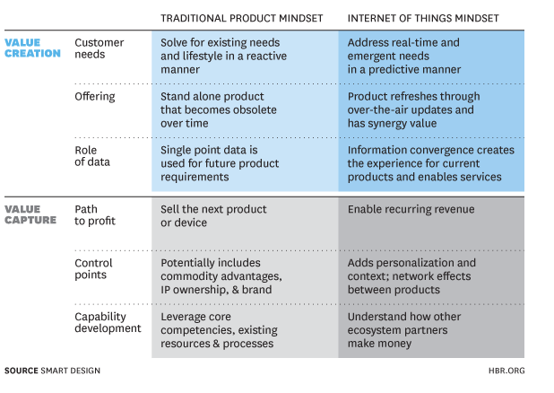
How value is created and captured?
Real-Time
Predictive
Personalization
Services

Slide 45
IMPACT ON Bargaining power of buyers.
Closer customer relationships : segment customers, customize products, set prices to better capture value, extend value-added services.
Costs of switching to a new supplier increase through capturing rich historical and product-usage data.
Smart products allow firms to reduce their dependency on distribution or service partners, or even disintermediate them.
Give buyers a better understanding of true product performance, allowing them to play one manufacturer off another.

Slide 46
Rivalry among competitors
Rivalry among competitors can also increase as smart products become part of broader product systems.
Connected products have the potential to shift rivalry, opening up numerous new avenues for differentiation and value-added services

Slide 47
Threat of new entrants
New entrants in a connected world face significant new obstacles, starting with the high fixed costs of more-complex product design, embedded technology, and multiple layers of new IT infrastructure.
Smart products can also increase buyer loyalty and switching costs, further raising barriers to entry.
Barriers to entry go down when smart products invalidate the strengths and assets of incumbents.
Apple HomeKit 2016

Slide 48
Threat of substitutes
A variation of product-as-a-service is the shared-usage model.
Smart products can offer superior performance, customization, and customer value relative to traditional substitute products, reducing substitution threats and improving industry growth and profitability.

Slide 49
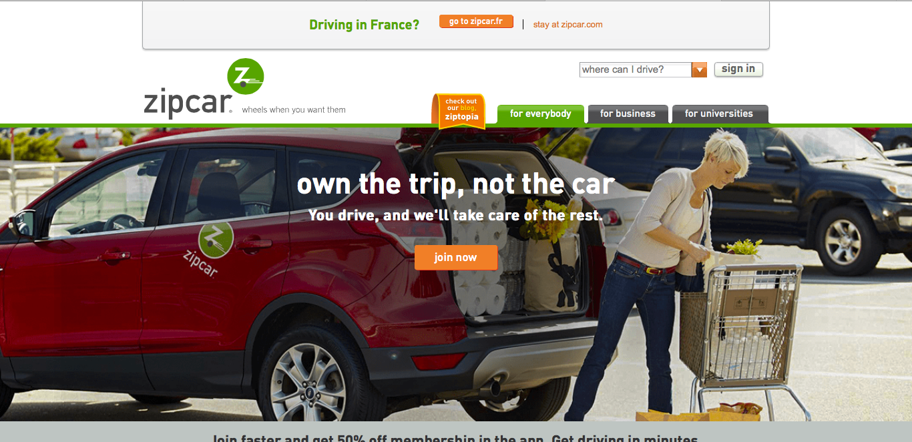
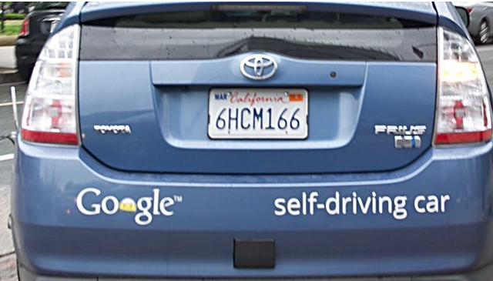
THREAT OF SUBSTITUTES-CAR INSDUSTRY
The peer to peer car sharing
Zip Car-2000
Ride-sharing company
Uber - 2009
Self Driving Car
Google Car-2010
https://dupress.deloitte.com/dup-us-en/focus/internet-of-things/iot-in-automotive-industry.html

Slide 50
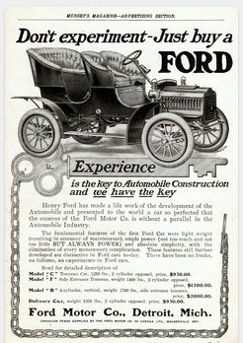
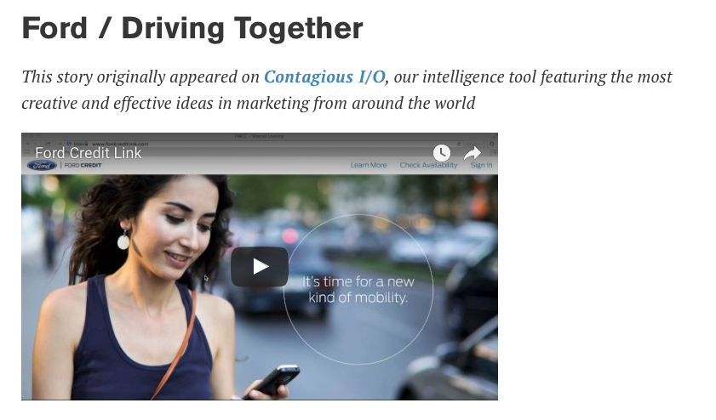
THREAT OF SUBSTITUTES-CAR INSDUSTRY
BEFORE
TODAY
Ford Credit Link
Readings : How Ford Plans to Survive the Next 100 Years?
http://www.roadandtrack.com/car-culture/news/a27726/how-ford-plans-to-survive-the-next-100-years/
https://media.ford.com/content/dam/fordmedia/North%20America/US/2015/01/07/FordSmartMobilityMap.pdf

Slide 51
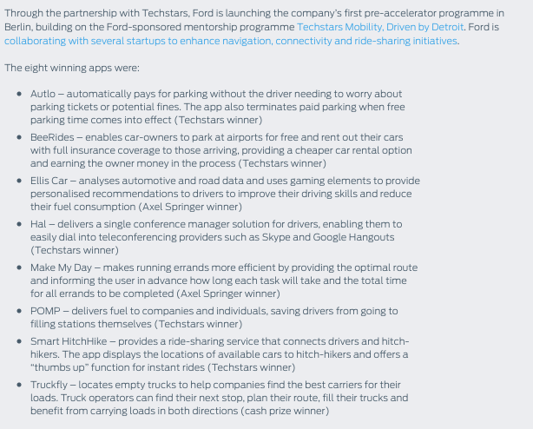
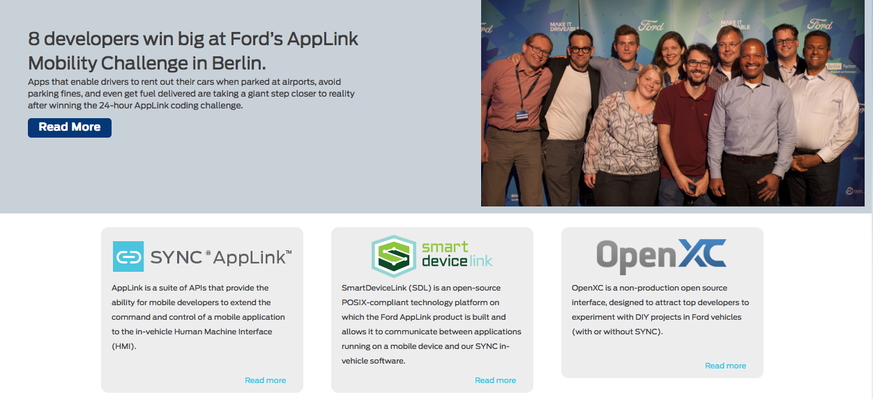
THREAT OF SUBSTITUTES-CAR INSDUSTRY
Mobility Challenge
https://media.ford.com/content/dam/fordmedia/North%20America/US/2015/01/07/FordSmartMobilityMap.pdf

Slide 52
Bargaining power of suppliers
Bargaining Power of traditional suppliers:
As the smart and connectivity components of products deliver more value relative to physical components, the physical components can be commoditized or even replaced by software over time.
Bargaining power of new suppliers :
Smart products often introduce powerful new suppliers that manufacturers have never needed before: providers of sensors, software, connectivity, embedded operating systems, and data storage, analytics, and other parts of the technology stack.

Slide 53
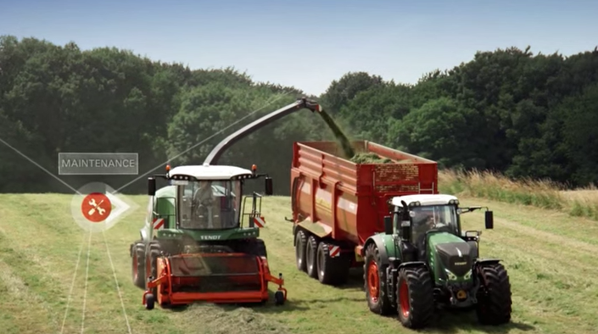
NEW INDUSTRY BOUNDARIES: SYSTEM OF SYSTEMS
From the smart product to the system of systems
AGCO: Connecting Your Farm Enterprise Like Never Before, 2015

Slide 54
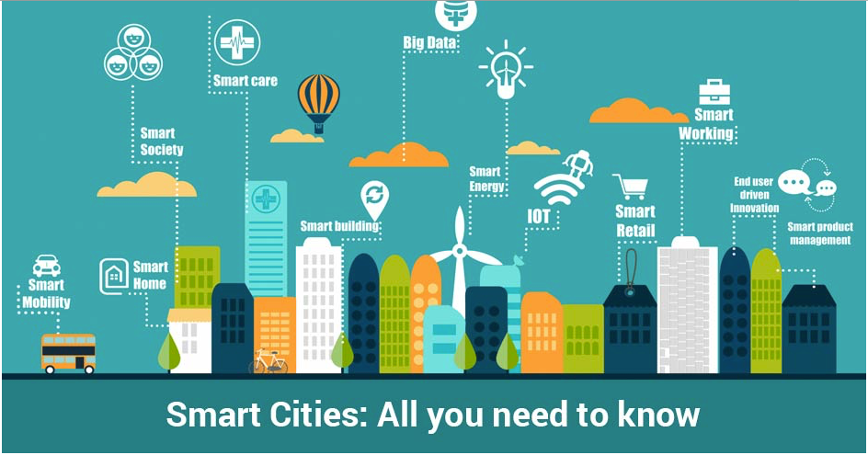
SMART CITY IS THE SYSTEM OF SYSTEMS
By 2050, 70 percent of people on Earth will
live in cities! Smart Cities?
The smart city is a system of Different Systems : Transportation, Energy, Healthcare, Commerce, Education, Security, Food and Water…..
Vision of AT&T
Vision of Cisco
Vision of Samsung
Barcelona

Slide 55
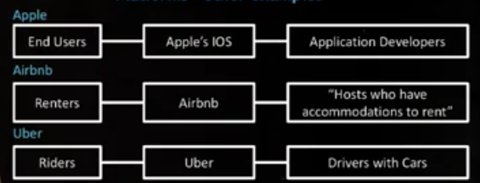
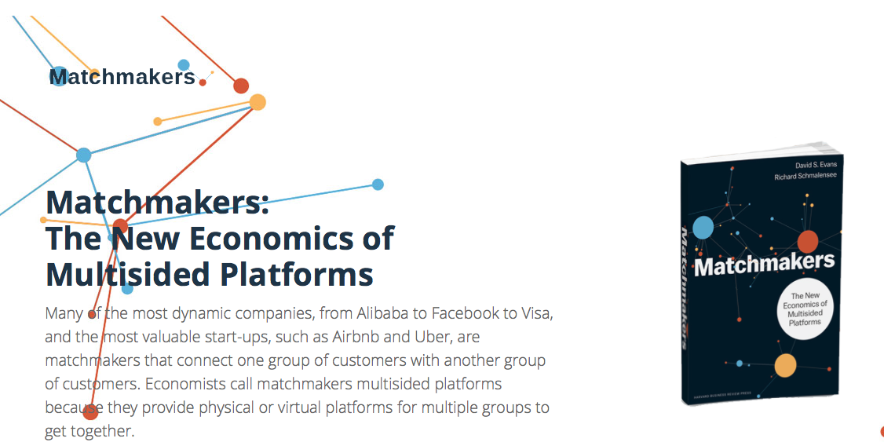
THE EMERGENCE OF THE « PLATFORM ECONOMICS » FOR IoT
Plateforms Economics
New systems where value is being created outside the firm.
Apple gets 30 percent of the cut from other people’s innovations in its app store.
Matchmarkets
A published standard that lets others connect to it, together with a governance model, which is the rules of who gets what.
Business platforms are often engaged in consummating a match. It’s a match between riders and drivers with Uber. It’s between travelers and spare capacity of guest rooms in Airbnb.
http://matchmakereconomics.com

Slide 56
THE EMERGENCE OF THE « PLATFORM ECONOMICS » FOR IoT
BUYERS
PLATFORMS
SELLERS
DATA-USING APPLICATIONS
NETWORK
INTERCONNECTION
DATA GATHERING SENSORS

